Slide 1



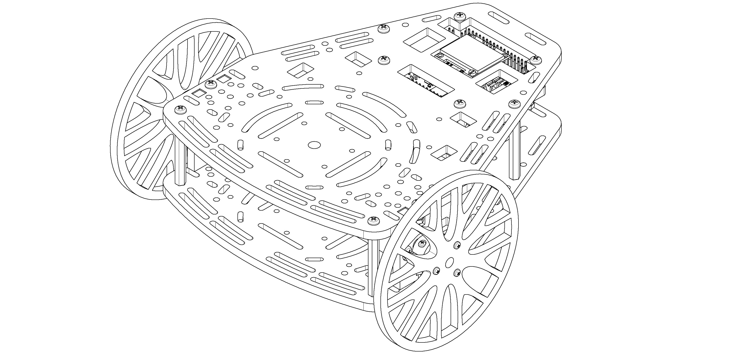
Introduction to ROS
From zero to a functional communication scheme

Slide 2
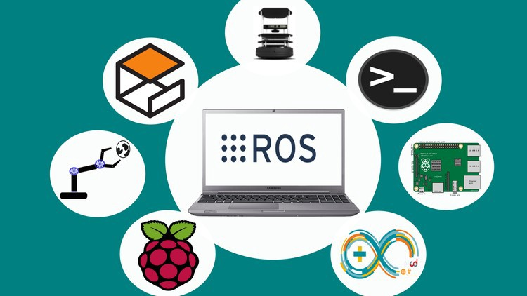
ROS basics What is ROS ?
“ROS is an open-source framework that helps researchers and developers build and reuse code between robotics applications”

Slide 3
ROS basics The conceptual idea behind ROS
University
Teacher 1
Teacher 2
/ROS
/Control
/ROS
Student B
/Weekend
/Control
Student C
Student A
/Party
Student D

Slide 4
ROS basics What is the information delivered?
Any class has a certain format, which both the teacher and the student know off and is expected to be followed.
Between two friends you are not expecting a power point presentation but some plain text.
Publishers
Data types
Subscribers
Teacher
/ROS
Presentation and a
practical explanation
Students
Student
/Weekend
Plain text and memes
Student

Slide 5
ROS basics ROS versions
New versions of ROS are released with each Linux distributions, due to compatibility in this course we are going to be working with ROS melodic (released with Ubuntu 18.04).
Currently there’s another version of ROS available for Ubuntu 20.04 and a revision of the ROS structure, known as ROS2, that aims to increase the robustness of the framework for industrial applications and distributed systems. Furthermore, ROS2 allows real time applications.

Slide 6
ROS Architecture ROS Master
Brain of ROS -> Process manager that enables the communication between different agents in the network.
Allows communication between different computers or robots by means of a Server – Client architecture
ROS Master
User
Node 2
TCP IP Com
User
Node 1
Robot
Node
ROS Serial
Micro.
Node

Slide 7
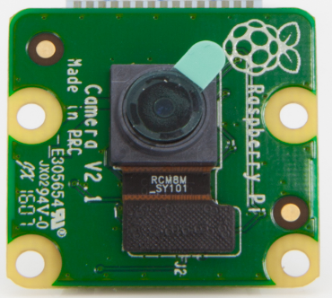
ROS Architecture nodes and topics
Piece of software that acts as an element in the network.
It is in charge of executing a part of the code and can be programmed in Cpp, Python or Lisp.
Each topic has a unique msg type.
Hardware
Node
Node
Obstacle detection
node
Get
data
/Image
Node
Cables
White line detection
node

Slide 8
ROS Architecture messages
std_msgs/Float32
geometry_msgs/PoseStamped
std_msgs/Header header
uint32 seq time stamp string frame_id geometry_msgs/Pose pose
geometry_msgs/Point position
float64 x float64 y float64 z geometry_msgs/Quaternion orientation
float64 x float64 y float64 z float64 w
float 32 data
sensor_msgs/Image
std_msgs/Header header uint32 height uint32 width string encoding uint8 is_bigendian uint32 step uint8[] data

Slide 9
ROS Architecture Services and actions
While topics are one way communication, services and actions allow feedback and prevent unnecessary load in the network.
Services follow a question-answer structure, while actions are designed to execute a task and give feedback during the process.
Control Node
User Input Node
Can you send me a path ?
Move to point A
Updated path
Updates:
Current pose
Success !
Planning Node
Control Node
Service
Action

Slide 10
ROS Architecture Services and actions
When defining either an action or a service we need to stablish each member involved in the communication. Usually both are project dependent, so users define their own structures.
Actions
Service
Request
Request
int64 a
int64 b
int64 a
int64 b
-----------------
-----------------
Feedback
Response
int64 c
int64 c
-----------------
Response
int64 d

Slide 11



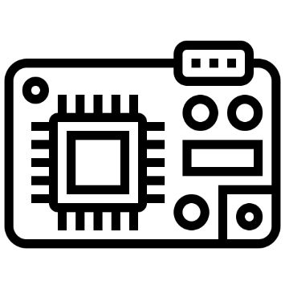
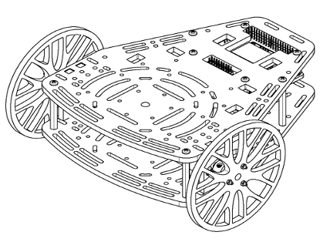
ROS Architecture A practical example
PC

Slide 12


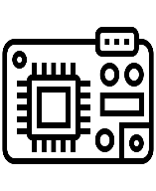
ROS Architecture Overview
Ros Master
Micro
User
Node
Sensors
Node
Control
Node
Actuators
Node
Physical System
ROS Implementation

Slide 13
ROS Architecture ROS Packages
Ros Packages are a way of organizing codes related between each other.
The same way teachers are gathered within the Engineering school nodes are gathered in ROS packages
Engineering School
Camera Package
MechEng
ElecEng
Data acquisition
Video
recording
CompSci
ChemEng
Video display

Slide 14
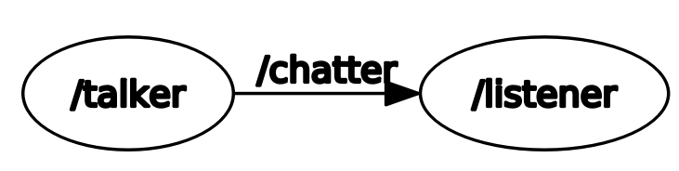
ROS Code Talker and listener framework
Simplest communication scheme.

Slide 15
ROS Code Talker
#!/usr/bin/env python import rospy from std_msgs.msg import String
if __name__ == '__main__': pub = rospy.Publisher("chatter", String, queue_size=10) rospy.init_node("talker") rate = rospy.Rate(10)
while not rospy.is_shutdown(): hello_str = "hello world %s" % rospy.get_time() pub.publish(hello_str)
rate.sleep()
Setup environment and import libraries
Create variables and setup node
Publish message
Wait to run again
Terminal Commands
roscore
rosrun basic_comms talker.py
rostopic echo /chatter

Slide 16
ROS Code Listener
#!/usr/bin/env python import rospy from std_msgs.msg import String
def callback(msg): rospy.loginfo("I heard %s", msg.data)
if __name__ == '__main__': rospy.init_node('listener') rospy.Subscriber("chatter", String, callback)
rospy.spin()
Setup environment and import libraries
Define Callback
Create variables and initialise node
Continuously check for new messages
Terminal Commands
roscore
rosrun basic_comms listener.py
rostopic pub /chatter <tab complete>

Slide 17
ROS Tools ROS Terminal tools
roscore
Must be executed before working with ros
Handles the correct functionality of the network
rostopic
Contains useful tools related with topics
rostopic echo [topic name]
rostopic list
rostopic hz [topic name]
rosrun
Executes a given node
rosrun [package] [node name]
rosnode
Contains useful tools related with nodes
rosnode list
rostopic info [node]

Slide 18
ROS Tools ROS Terminal tools II
roslaunch
Allows to launch multiple nodes with a single command by calling .launch files
roslaunch [package] [.launch]
rosbag
Records the activity of the topics in the network
rosbag record
rosbag info [bag file]
rosbag play [bag file]
config files
Load parameters into the system that can be accessed by any node
rqt
ROS visualization tool that provides graphical information of the system status

Slide 19
Activity Implement a listener-talker
Implement the code in either Python or Cpp.
Use some of the command line tools to verify the correct functioning of the system.

Slide 20
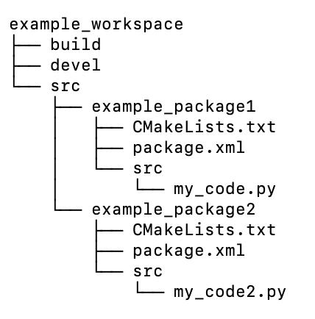
ROS Tools ROS File structure
ROS projects are organized using workspaces, which are a collection of grouped codes called packages.
Instructions for the compiler need to be allocated in .cmake and package files
Package files are exportable between projects
Configuration files used to stablish code dependencies
Code that we will execute
Catkin_make will generate ‘src’ and ‘devel’ for you when compiling the workspace

Slide 21
ROS Tools ROS Compilation tools
ROS requires to compile each package, generating dependencies related with other packages, external libraries or custom messages, services and actions.
The preferred compilation tool is known as catkin and uses two separated files, package.xml and CMakeLists.txt.
A useful command to create packages is:
catkin_create_pkg [name] [list of dependencies]
Which generates an empty package and templates of both CMakeLists and package files.
More information about the syntaxis of this files can be found In http://wiki.ros.org/ROS/Tutorials/CreatingPackage
Projects are compiled with the instruction catkin_make and the instruction source [project]/devel/setup.bash needs to be executed to load the changes.

Slide 22
ROS Tools ROS Parameter Server
ROS allows to load variables into the master which are accessible by all the nodes of the system.
Typically, a .yaml file is loaded into the system through a launch file and configuration parameters are stored there.
They are used them when loading robot models or constants that may vary in different scenarios where the same code is applied.
You will see an example of them in further days of the course
ROS Core
Control Node
Config.yaml
roslaunch
Parameter Server
Planning Node

Slide 23
ROS Tools ROS Launch
Master
ROS Launch
Node 1
Node 2
Config files

Slide 24
ROS Tools ROS Launch Syntax
Launch files are sets of commands written in xml that allow executing various scripts at the same time.
The general syntaxis is the following
<?xml version=“1.0”?>
<launch>
[Body of the launchfile]
</launch>
This syntaxis allows to run any object used within the ROS architecture and has a wide variety of tools that allow to parametrize the launch file so that it can be adapted to the requirements of you project.
An extensive documentation can be found in http://wiki.ros.org/roslaunch

Slide 25
ROS Tools ROS Launch code tools
Running a node
<node name=“listener” pkg=“basic_comms” type=“listener.py” output=“screen”/>
Running another file or launch file
<include file="$(dirname)/other.launch" />
Set parameters
<param name="publish_frequency" type="double" value="10.0" />
Pass args to the launch file
<arg name=”camera_id" value=”cam_3" />
Load files into the system
<rosparam command="load" file="$(find package_name)/config/file_name.yaml" />

Slide 26
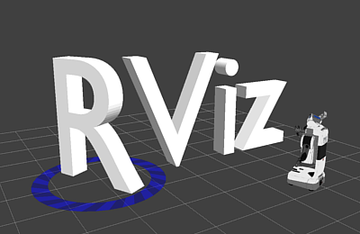
ROS tools Rviz visualization tool
Rviz is a program used to visualize 3D representations of any system simulated with ROS.
Is commonly used to represent sensor information, such as point clouds, spatial relationship between elements using transform frames or robots.
Remember that Rviz is only a visualization tool, it does not allow any kind of simulation.
Control Node
Planning Node

Slide 27
Example Mobile robot visualisation
Ros Master
Simulator
User
Node
Control
Node
Model
Node
ROS Implementation
Notes:
Add marcs image, and mario’s image

Slide 28
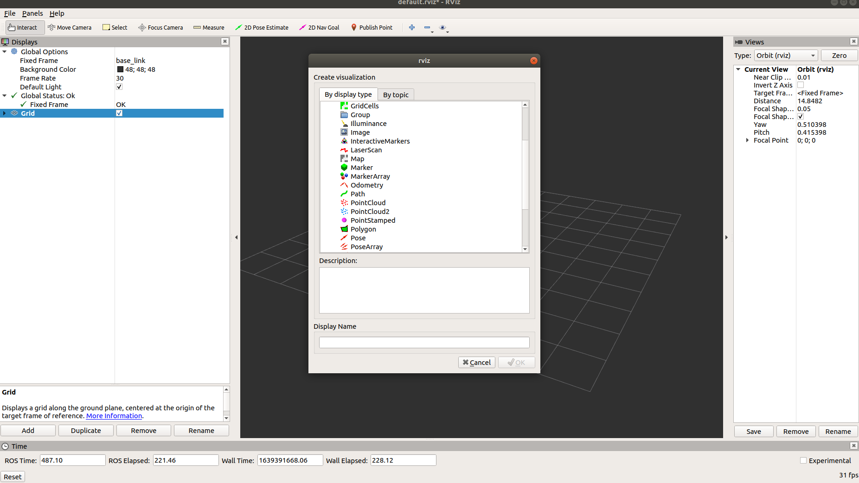
RViz Example Displaying information from a camera
In order to display information from a camera we need to follow these steps
Set up a fixed frame that acts as the origin of our world
Select a topic containing the images that we want to display
“Global options” allow to set up a common reference frame and background for all the objects visualized
The ”add” tab is used to manage information
Notes:
Teacher shares screen and plots info from the robot, f.e setting a camera

Slide 29
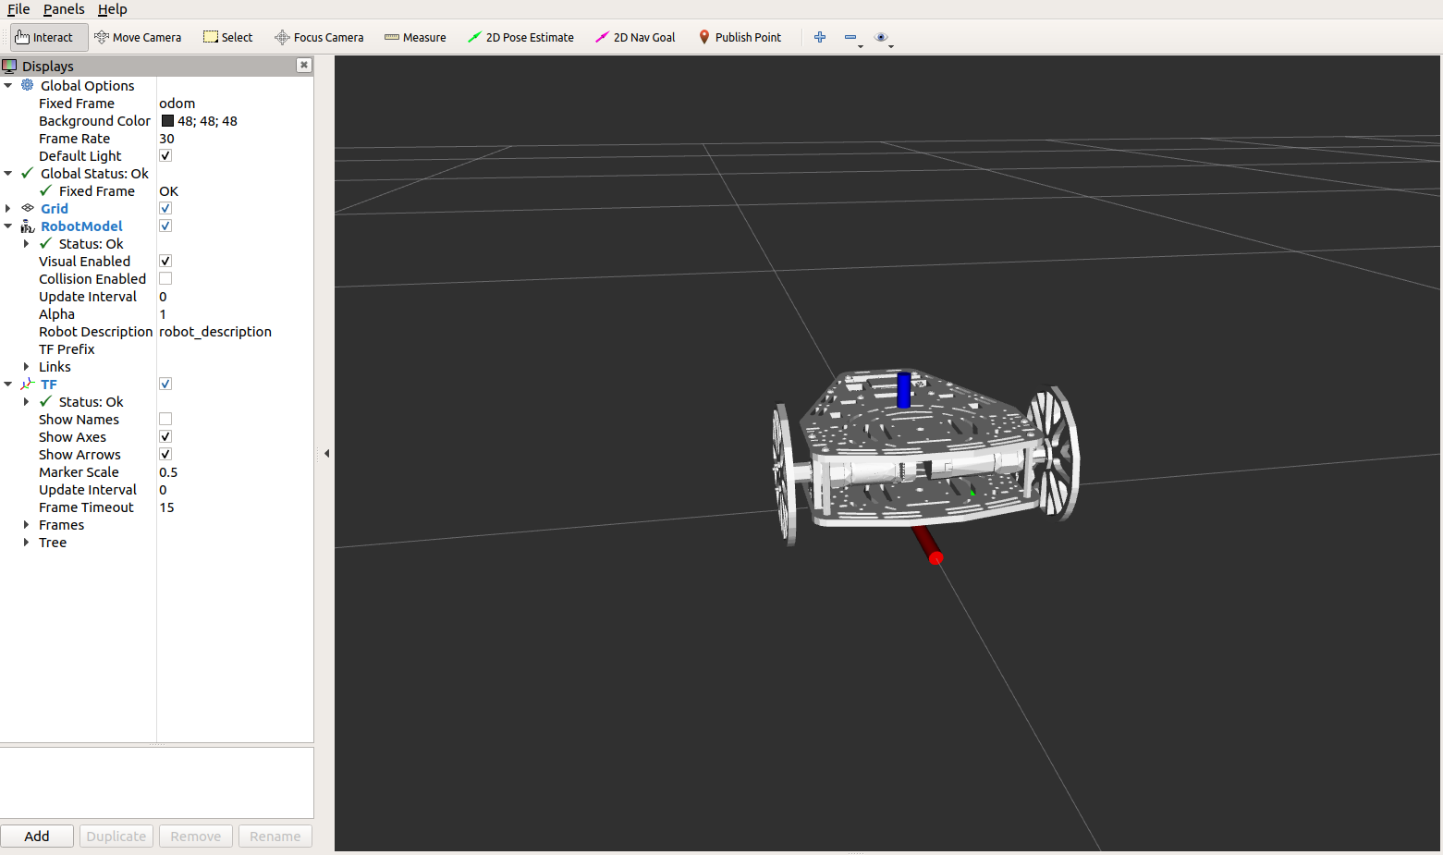
RViz Example Loading and moving a robot in Rviz
In order to display the movement of a robot in Rviz we need to follow these steps:
Set up a fixed frame that acts as the origin of our world
Add a robot object
Link it to a 3D model and a topic describing its state
“Global options” allow to set up a common reference frame and background for all the objects visualized
The ”RobotModel” tab is used to link a robot model (Robot Descriptor) and position information (links)
Notes:
Teacher shares screen and plots info from the robot, f.e setting a camera

Slide 30
ROS tools Saving and opening Rviz configurations
Once your Rviz environment is properly set up you can save it using the tab file -> save, this generates a .rviz file that can be launched within any roslaunch file.
The code used to do so is the following and can be added to any of the ros files
<node name=”rviz” pkg=“rviz” args=“-d [file path]” required=”true” />
Remember that if your rviz required a robot model it need to be loaded into the system by adding:
<param name=”robot_description” coomand=[model path]/>
This will execute your code along with an Rviz window, allowing to display the information that you find relevant to your application
Notes:
Teacher make this steps sharing the screen, using the opportunity to show a Cmake List and a package.xml

Slide 31
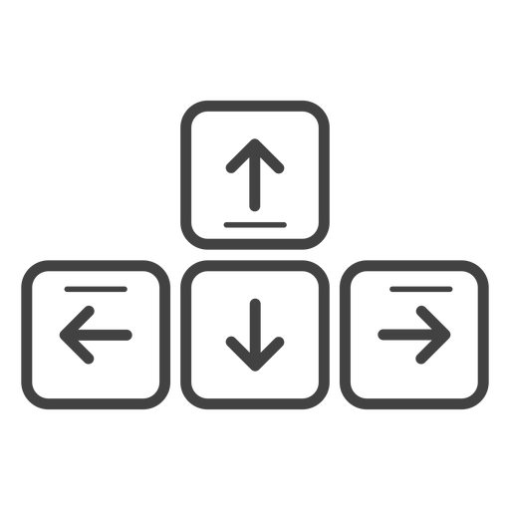
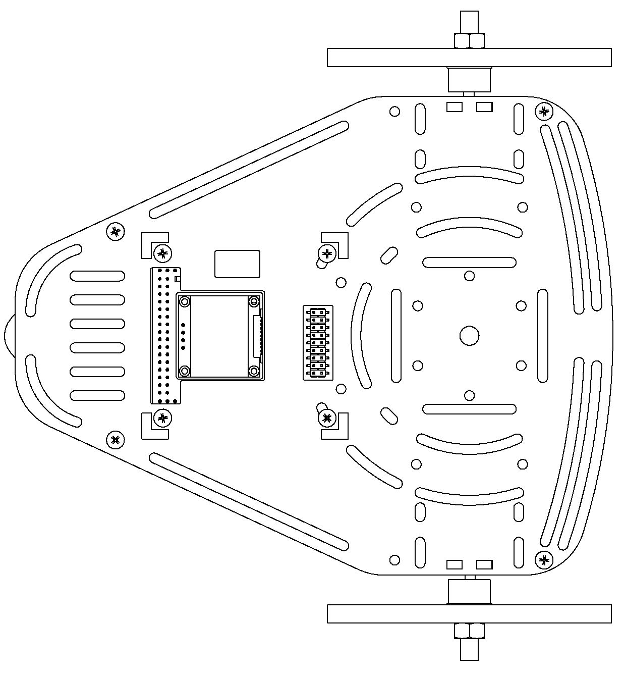
Activity Teleoperate a PuzzleBot
Teleoperation
Square
Input in the terminal the commands to move the robot
See how the robot traverses accordingly the environment.

Slide 32
Activity Moving a PuzzleBot
Straight line
Square
Drive the robot in a straight line.
Drive the robot making a square with a side length of 1m.

Slide 33
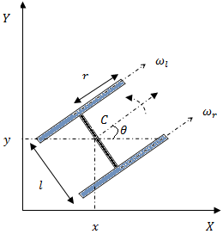
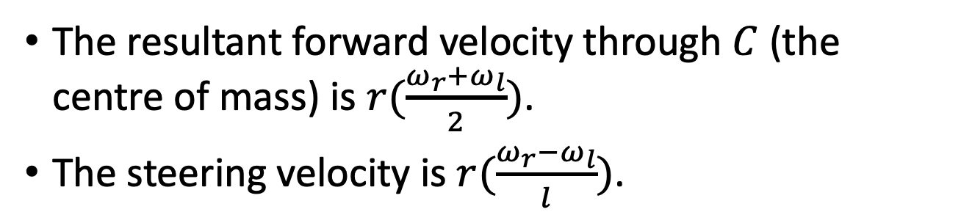
Activity How is the robot modelled?
The resultant forward velocity through $C$ (the centre of mass) is $r(\frac{ω_{r}+ω_{l}}{2})$.
The steering velocity is $r(\frac{ω_{r}−ω_{l}}{l})$.

Slide 34
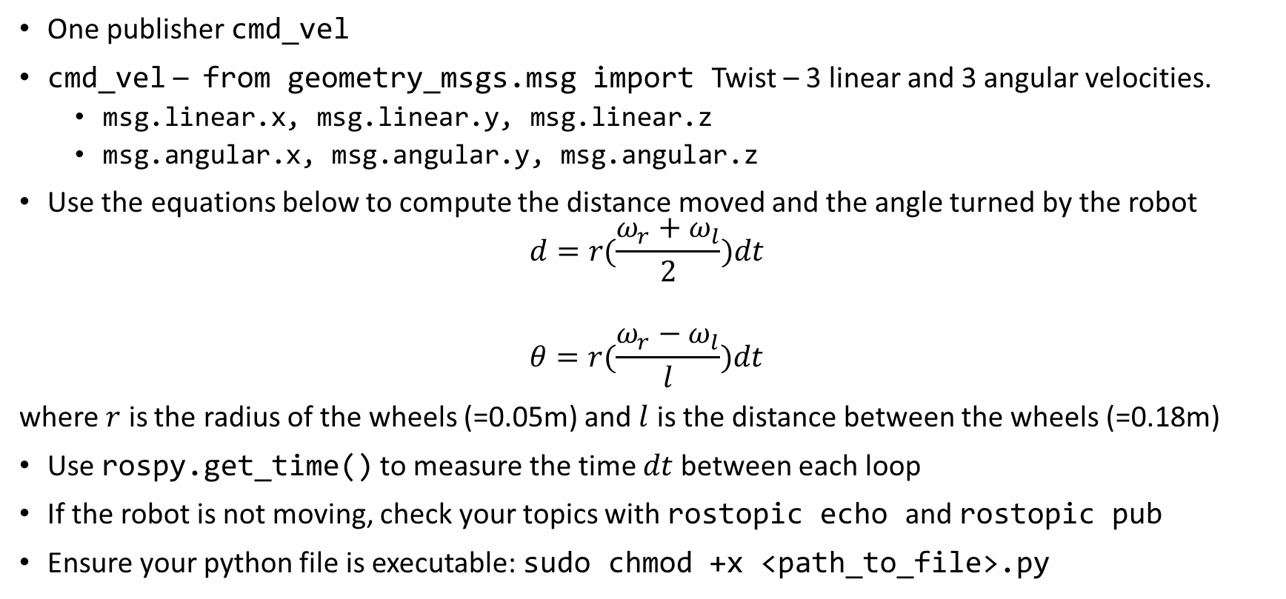
Activity Some tips and tricks
One publisher cmd_vel
cmd_vel – from geometry_msgs.msg import Twist – 3 linear and 3 angular velocities.
msg.linear.x, msg.linear.y, msg.linear.z
msg.angular.x, msg.angular.y, msg.angular.z
Use the equations below to compute the distance moved and the angle turned by the robot
$$d=r(\frac{ω_{r}+ω_{l}}{2})dt$$
$$θ=r(\frac{ω_{r}−ω_{l}}{l})dt$$
where $r$ is the radius of the wheels (=0.05m) and $l$ is the distance between the wheels (=0.18m)
Use rospy.get_time() to measure the time $dt$between each loop
If the robot is not moving, check your topics with rostopic echo and rostopic pub
Ensure your python file is executable: sudo chmod +x <path_to_file>.py

